Slide 1
Adidas Coding Challenge
Subscription Service
Mikel Antolin Sola – 17/06/2018

Slide 2
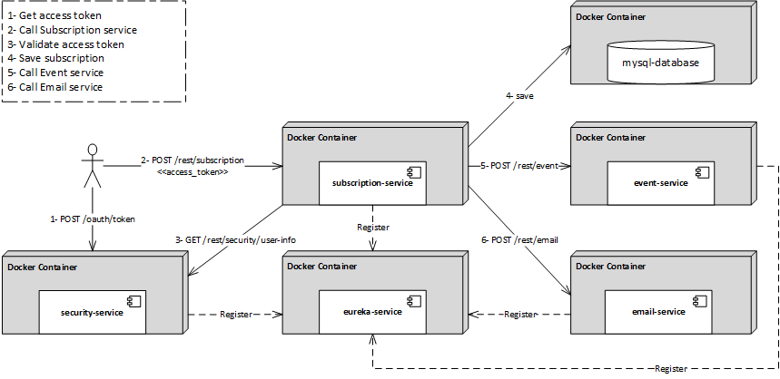
Solution

Slide 3
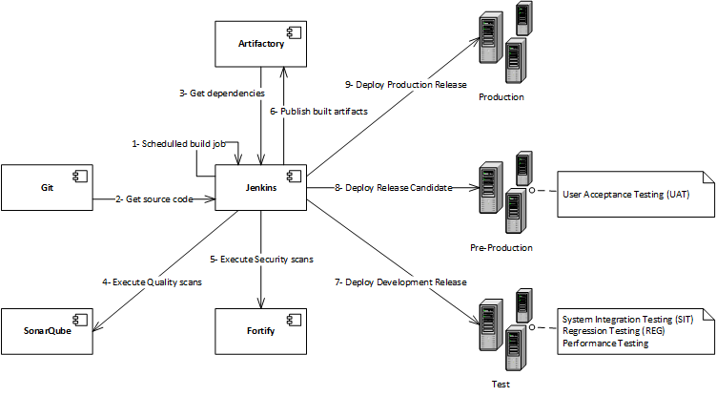
CI/CD pipeline

